Slide 1
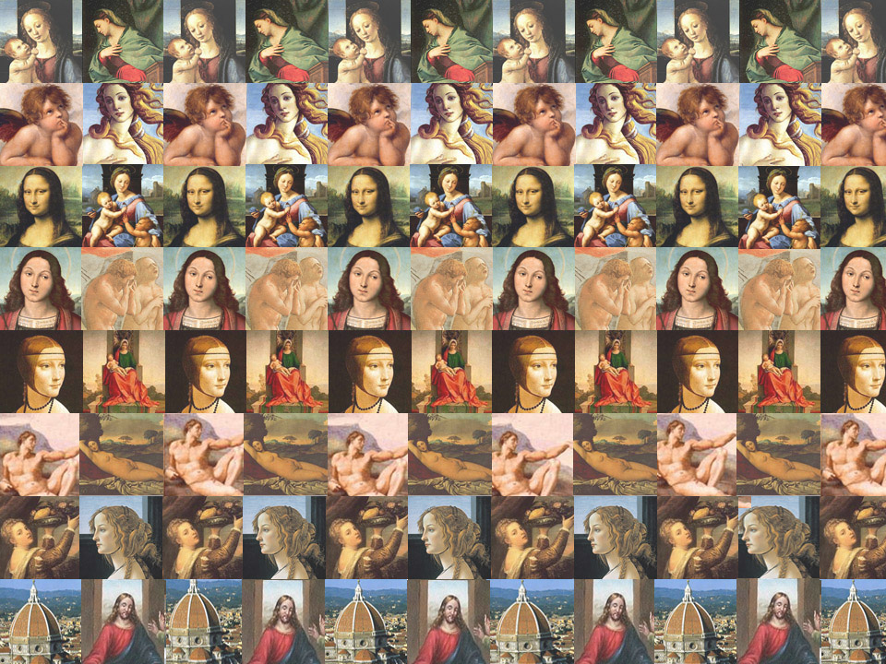
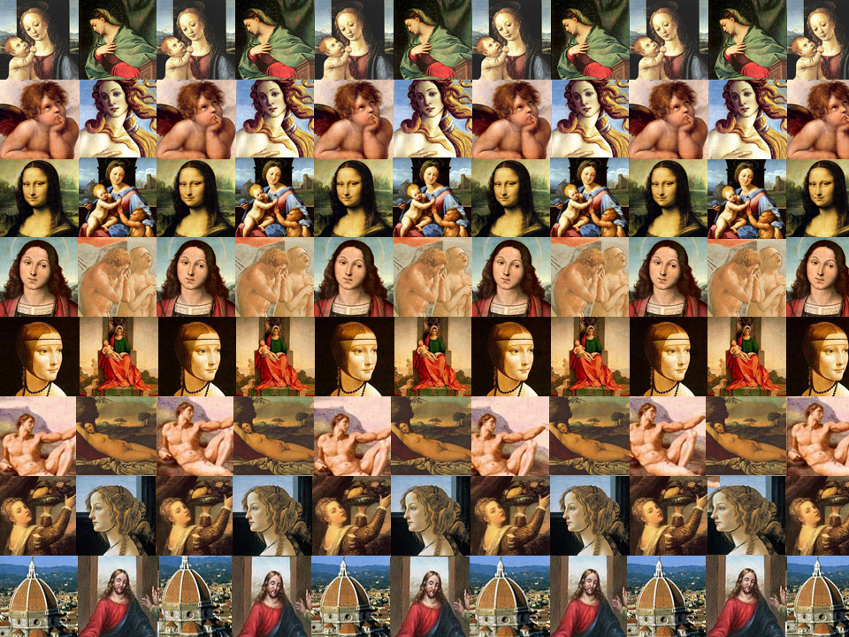

The Italian
Renaissance
By:
Irena Yang

Slide 2

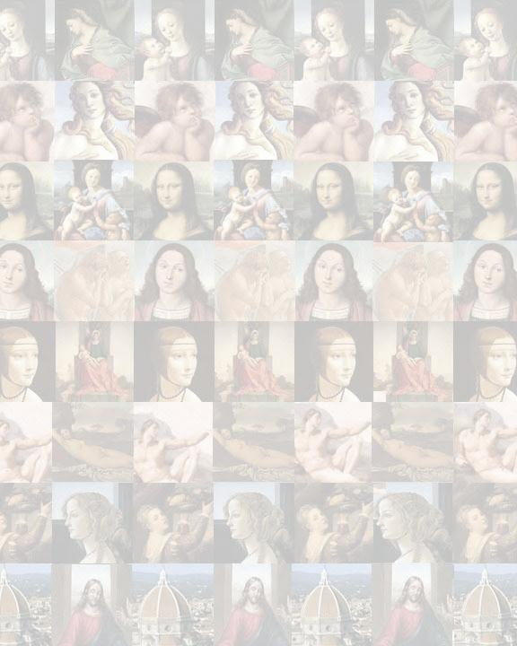
What was the Renaissance?
During 14th -17th century, a new, modern way of thinking about the world replaced an old, backward one of the Middle Ages
“Rebirth,” described the revival of classical learning and a rediscovery of ancient Rome and Greece
Europe experienced financial growth after the stagnation of the Middle Ages
Most importantly, the Renaissance was an age in which artistic, social, scientific, and philosophical thought turned in new directions

Slide 3
Why Florence, Italy?
Wealth
Merchants and bankers resided in Florence
Patronage
More wealth came a desire to enjoy pleasures of life!
Florentines were also proud of their government
A republic is, after all, a place that respects the opinions of individuals,
Growing middle and upper class– wealth accumulated
Wealthy bankers (Medici Family) were able to finance and patronize the arts, providing employment for the famous painters, sculptors, and architects of the time
Republic
Florence became a rich city
This individualism was an important part of the Humanism that thrived in Florence
Italy also had reminders of the Roman past—the roads, the aqueducts, the public buildings and monuments—which contributed towards a new respect and admiration for the classical age (“Focus on Florence”)

Slide 4
The Literary Renaissance
2 related developments: the establishment of an Italian vernacular (a national language) and the development of Humanism
During Middle Ages language was Latin, yet beginnings of literatures that were written in vernacular languages started to appear
The dialect of Italian vernacular was Tuscan, which was the dialect of the area around Florence
This emergence was primarily due to the work of three writers: Petrarch, Dante, and Boccaccio

Slide 5
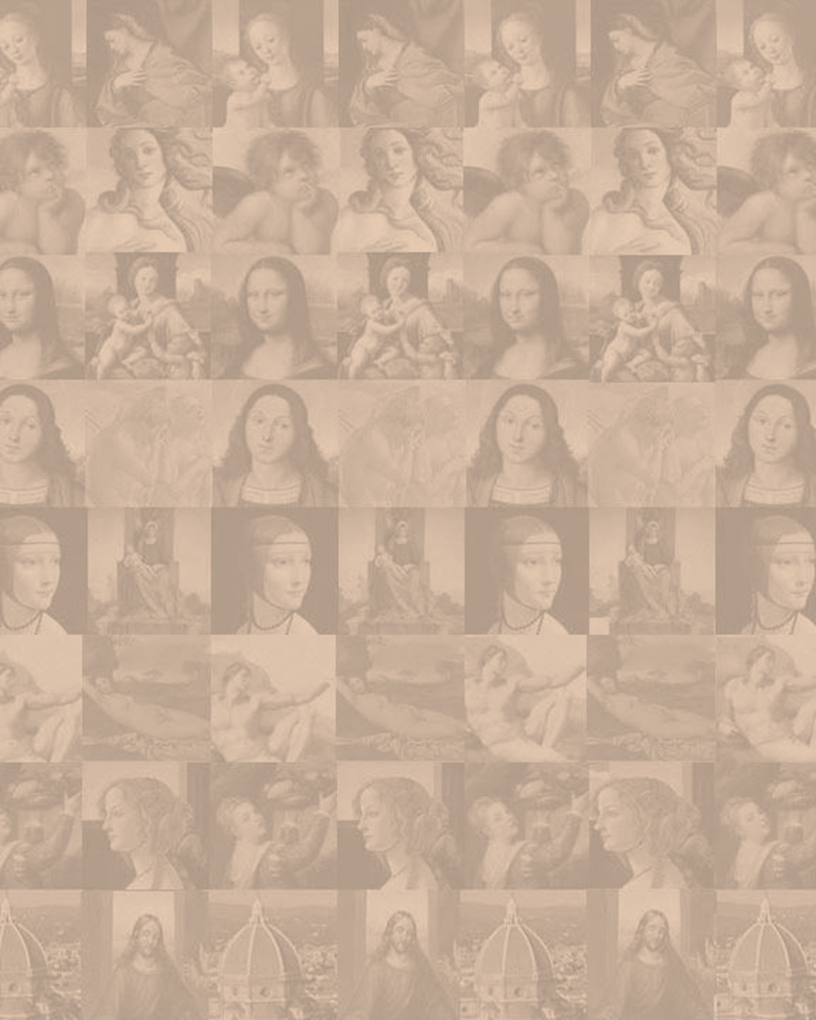
Humanism
The study and revival of the classics that originated from the ancient Greeks and Romans
Stressed grammar, rhetoric, history, literary studies and moral philosophy
Faith in the individual was a huge transformation from passivity and dependence on the church
Goal was not to condemn Church doctrines or beliefs
Some humanists were hired to write official correspondence and propaganda for the Pope
But was also declared “a dangerous doctrine” by the Church ("Humanism")
Influenced literature, the writing history, education, and style of life
Greatest influence on Italian Renaissance art, its style and subject matter, and variety of production (“The Renaissance Humanists”)

Slide 6
Famous Humanists
Francesco Petrarch (1304 –1374)
Father of Humanism
Dante Alighieri
(1265–1321)
Boccaccio
(1313 –1375)
First scholar of medieval time to recognize true significance of classical Latin prose and poetry
People could only improve by emulating ancients (Cicero, St. Augustine)
Founded philology, the systematic and scientific study of all literary and linguistic phenomena
Got support for Humanism among the rich and powerful
Passion for collecting ancient manuscripts
Perception that the future of classical scholarship depended upon the recovery of Greek works
Reconciliation between pagan and Christian ways of thinking
Click ALL the Links!
Everything like this a link (except for this ☺)
Wrote: The Decameron

Slide 7
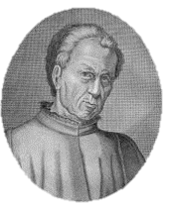
Civic Humanism
        Stressed active, participatory, patriotic citizenship + ethos and educational ideals
This movement is taken as a turning point away from medieval ways and towards liberating modernity
Differed from Petrarch’s contemplative life (isolation)
Civic humanists felt only by participating in public affairs could one live a virtuous life
Republican government best! Educated must use wisdom to help society– shown by ancients
Who’s this? Click to Find Out!

Slide 8
Humanism & Education
A new, rigorous kind of classical scholarship arose
Guarino da Verona and Vittorino da Feltre both emphasized:
  The study of classical Latin and Greek
  The well-rounded training of the mental, moral, physical aspects of their pupils
  Preparation for public life
  Would have agreed that a humanistic, or liberal, education was highly practical, since it fitted the pupil whatever his future profession to take his place in society
  Humanistic education was not found everywhere (Humanism itself wasn’t the only intellectual activity of the time)
  Humanistic ideal would later set the pattern for education, especially higher education
        Click to Learn More: * All Italian Renaissance (Education pg. 383-384)

Slide 9
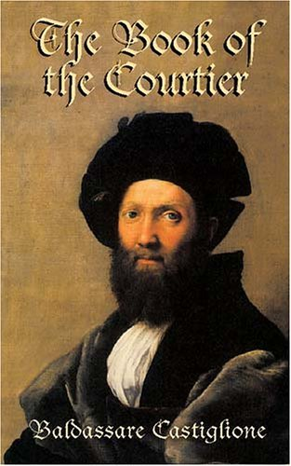
Society & Behavior
Age of humanism and patronage replaced chivalry of the Middle Ages
New image of acceptable behavior emerged
  This lifestyle was promoted in
  Castiglione’s The Courtier
  Humanist education and redefined
  behavior was associated with upper
  class and wealthy elite
  Very few were actually literate and
  only wealthy were influenced by
  Humanist advances

Slide 10
The Neo-Platonists
Florentine philosophers influenced by works of Plato
Academy under the patronage of Cosimo de Medici
Believed: 1) Entire universe is hierarchy (God on top) 2) Everyone attempts or contemplates perfection; free-will to seek it or not
MARSILIO FICINO (1433-1499)
Medici family ‘discovered’ him
Ideals of dignity and immortality of the human soul
PICO DELLA MIRANDOLA (1463-1494)
Translated Plato’s works from Greek to Latin
Most gifted Neo-platonist
Excerpt: “...O supreme generosity of God the Father, O highest most marvelous felicity of man! To him it is granted to have whatever he chooses, to be whatever he wills.”
Emphasis on man and his potential in this world
Oration on the Dignity of Man, gave humans a special rank in the universe between the beasts and angels

Slide 11
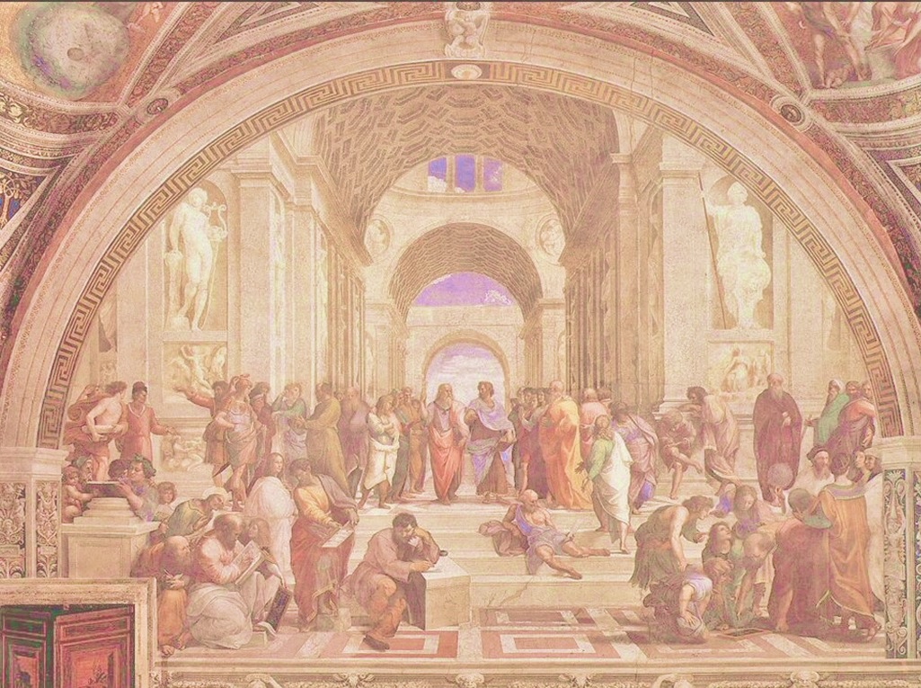
Advances in Art
Painting
  Perspective: 3-D
    Medieval works looked flat and 2-D
      Chiaroscuro: use of dark/light to create depth
      Faces expressed unique individualism and emotions
        Sculpture
          Free-standing, heavily influenced by ancients
            Medieval sculpture done in relief
            Glorified human body and portrayed nude
            Architecture
              Used Greek and Roman forms
                Ex. Greek temple architecture
                Simplicity, symmetry, balance
                Contrasted with medieval gothic style of pointed arches
                (“The Renaissance”)
                Giotto (Considered first Renaissance painter; used Chiaroscuro)

Slide 12
3 Friends
Masaccio (1401-1428)
Donatello (1286-1466)
First renaissance sculptor to utilize nude figures
Bronze David, first since antiquity
Brunelleschi (1377-1446)
Expulsion of Adam and Eve: extreme emotions
Earliest renaissance painters to portray real, nude figures
Used Brunelleschi’s perspective
Symbolized youth– became favorite hero among Florentines
Sculptures had similar qualities as Masaccio’s paintings
  Considered father of perspective
  Il Duomo: largest dome in Europe at time of construction
  Built by rings– not scaffolding
  Climax of Florentine renaissance

Slide 13
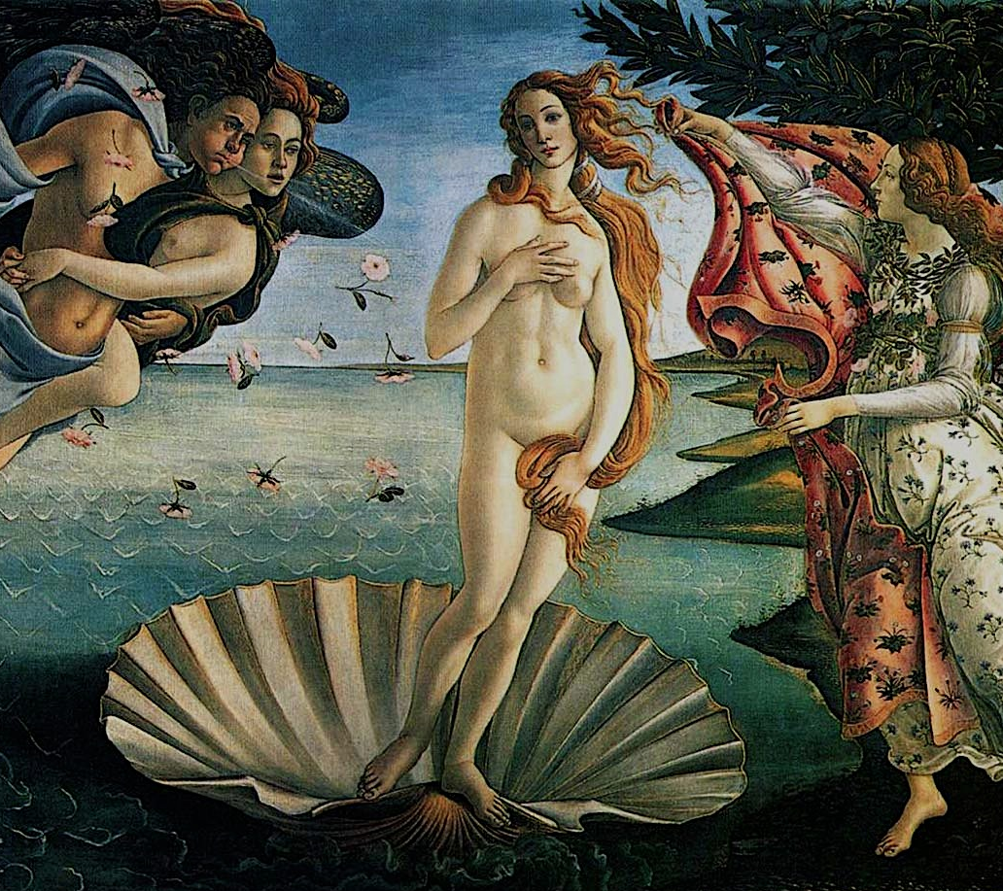
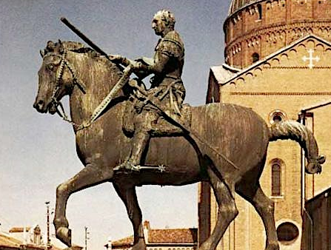
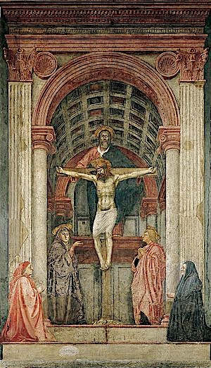
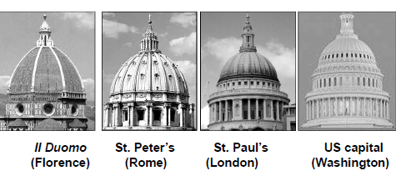
Click image for detail!
Donatello Gattamelata
Sandro Boticelli Venus
Masaccio Holy Trinity

Slide 14
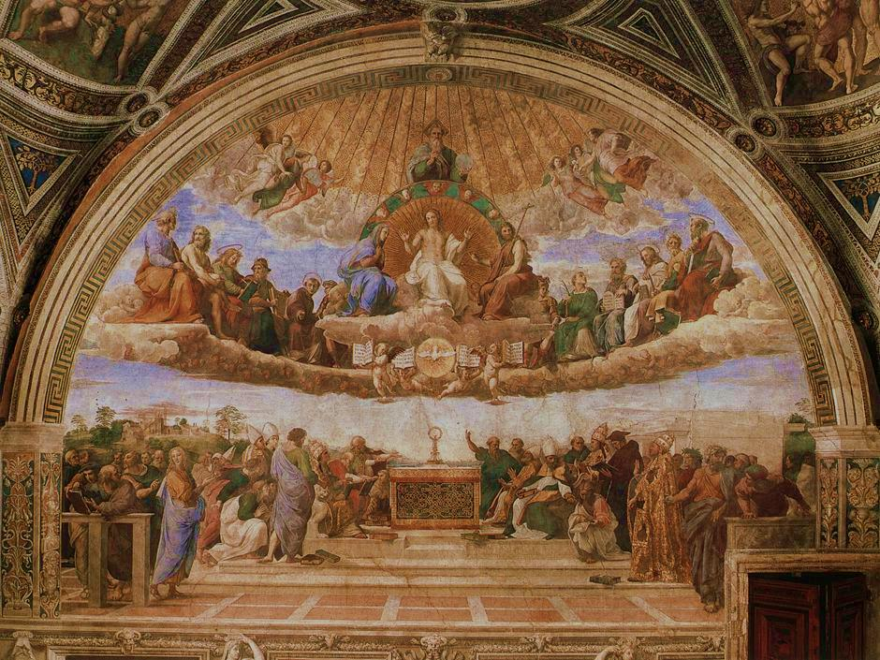
High Renaissance Art
Peak of renaissance in Florence ended in the 1490s
High Renaissance centered in Rome during 16th Century
Renaissance popes--Alexander VI, Julius II and Leo X– provided patronage
represented a convergence of talent and wealth of talent
Artists had the tools, technology, training and confidence to go their own way
Classical balance, harmony, restraint (“The Renaissance”)

Slide 15
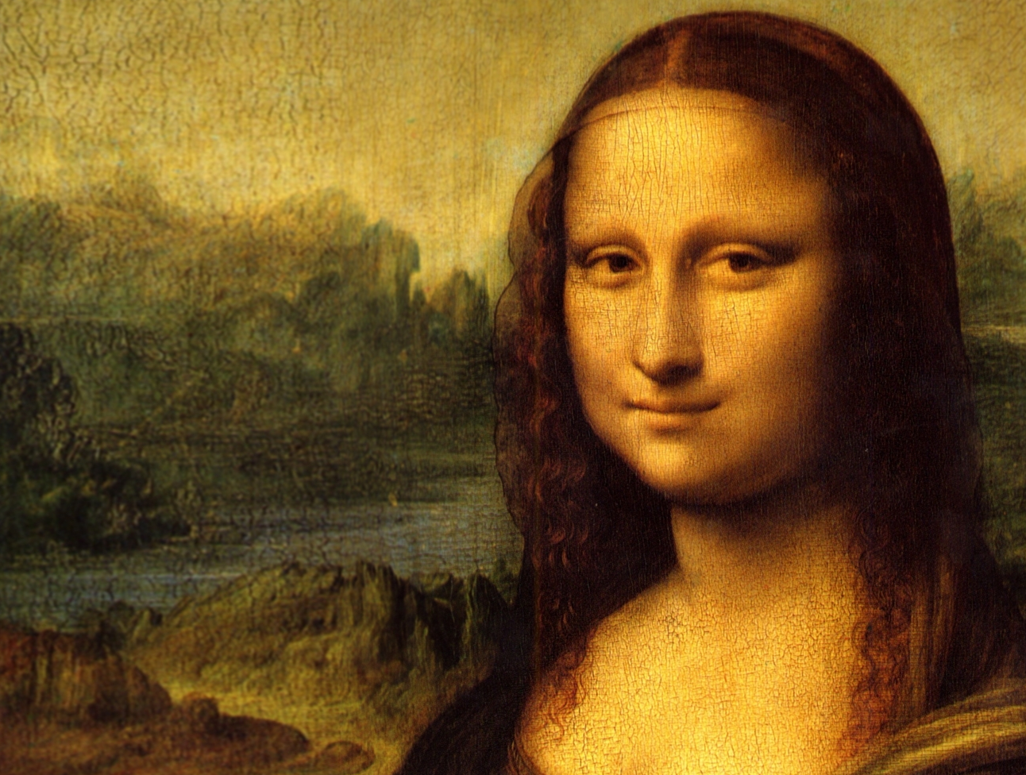
Leonardo da Vinci
The ideal “Renaissance Man”
Painter, sculptor, architect, engineer, writer, scientist
Developed sfumato, a technique of blurring or softening sharp outlines (ex. The Last Supper)
Used chiaroscuro, which
gave his paintings the
soft, lifelike quality
Check out complete works: http://www.leonardoda-vinci.org/
He turned to science in
the quest to improve his artwork
Studied nature and anatomy to create realistic paintings
dissections of the human body paved the way for remarkably accurate figures
Used rules of perspective and nature
Mona Lisa da Vinci?
A theory developed that Mona Lisa is actually a self-portrait of Leonardo! Evidence for this theory includes X-rays of the painting and close comparison with drawings of Leonardo

Slide 16
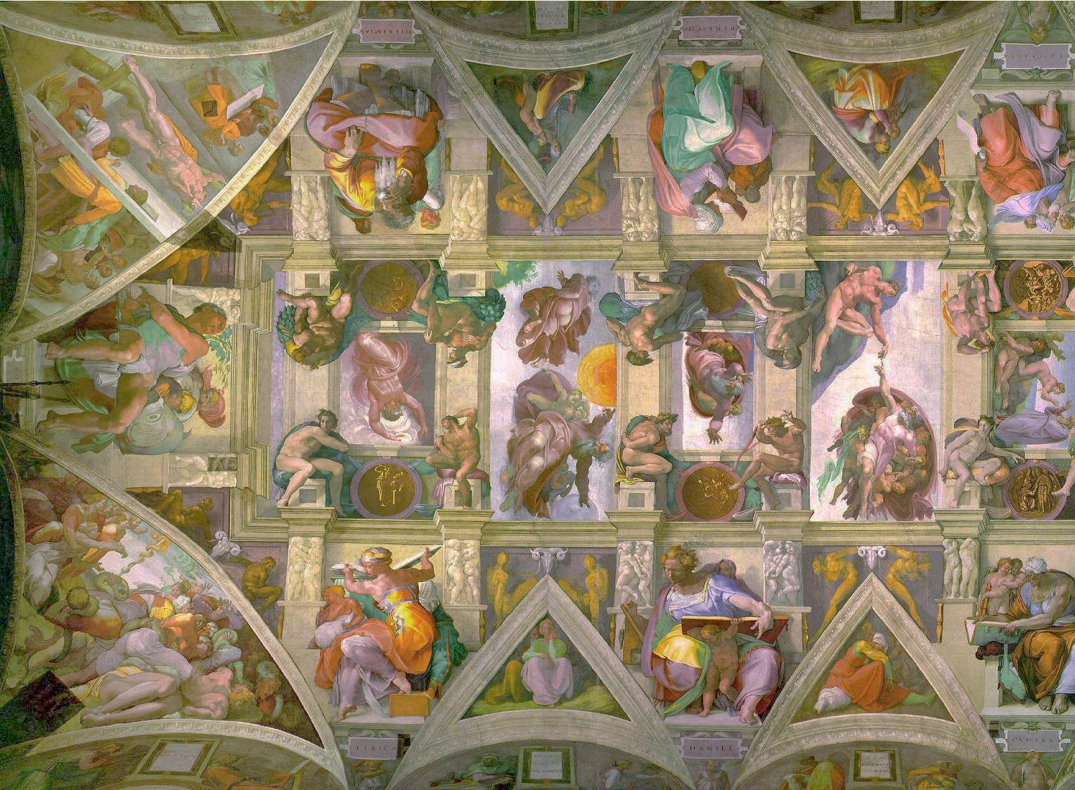
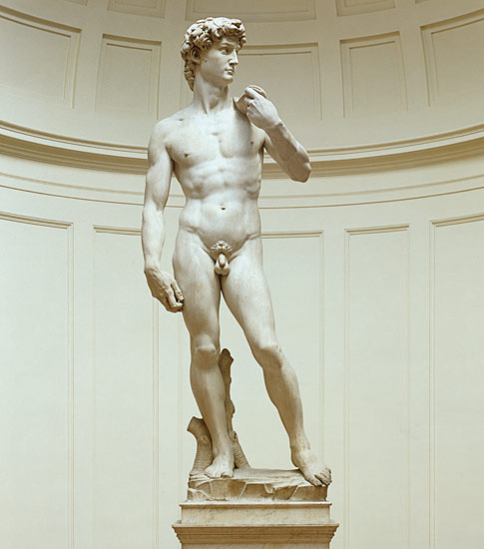
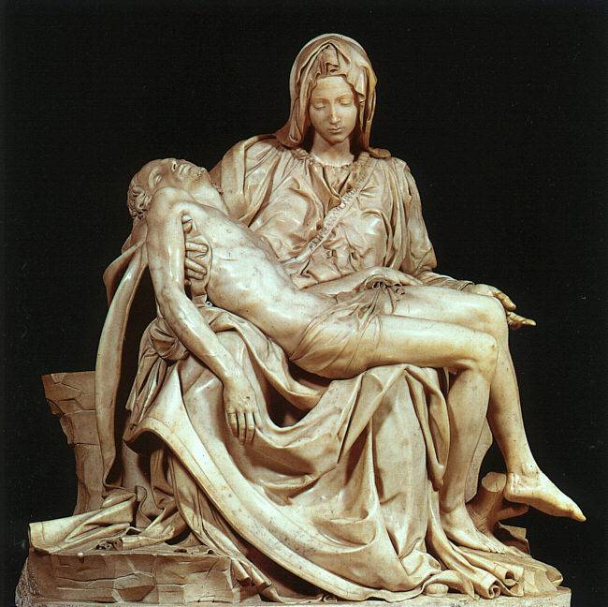
Pieta (1499): Mary holding limp body of Christ considered perhaps the most perfect marble sculpture ever made
David (1501-04): Humanistic marble sculpture—glorifies the human body; contrapposto stance; facial features are individualistic and emotional
Creation of Man
(1512): Part of
Sistine Chapel;
illustrates book of
Genesis in which God
breathes life into Adam
Painter, poet, architect, sculptor
Born into a poor family, often took on jobs he never finished
Must see: The Agony and the Ecstasy
Michelangelo

Slide 17
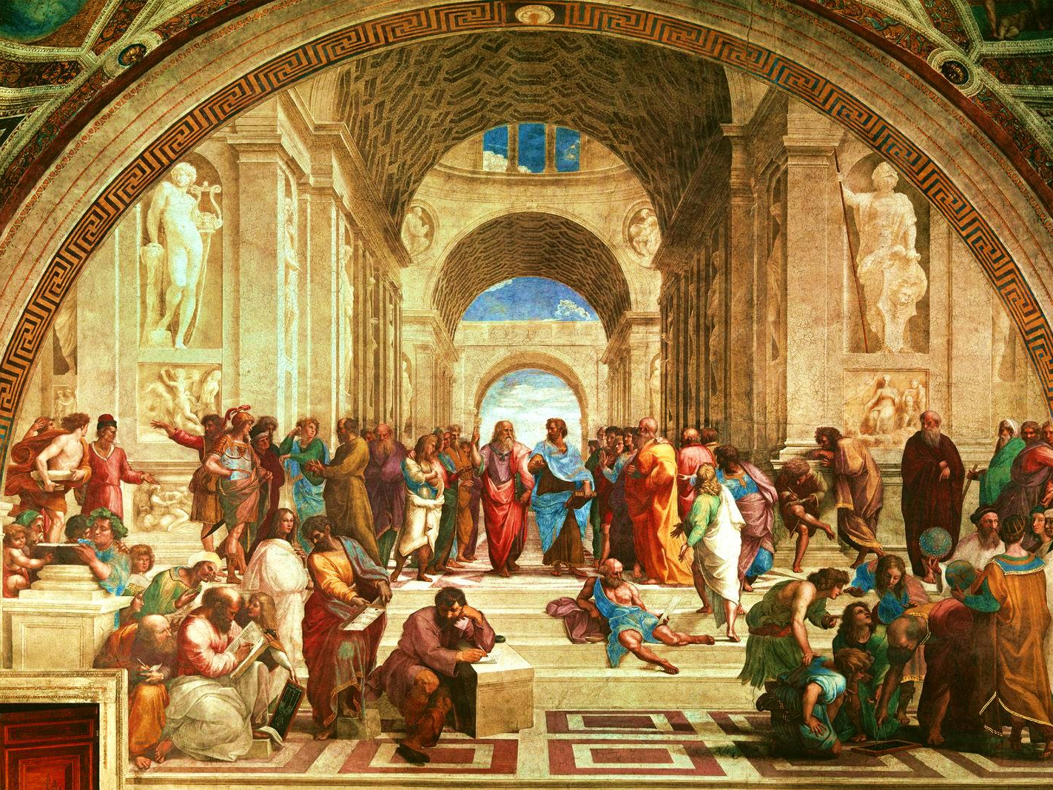
School of Athens (background) example of humanism
Plato & Aristotle are in the center of the painting
Greco-Roman architecture is prominent
-His sculptures are painted in contrapposto stance
-Created numerous “Madonna and Child” paintings
-paintings showed relaxation
Raphael
(1483-1520)

Slide 18
Most sought after portraitist
Used bold colors and movement to give a realistic quality to his art
Contrasted from subtle colors of Florence
Titian
(1488–1576)
The Assumption of the Virgin (1516–18) established Titian as the leading painter of Venice

Slide 19
Status and Perception
During generation of Masaccio and Brunelleschi, few artists gained fame
By Humanist movement, however, status of artist changed
  Humanist interest in personal fame encouraged secularism
  Artists became high prized and created a new social identity (Chambers 140)
  New, wealthy patrons
    Isabelle d’Este
  Local churches increasingly saw Renaissance art as a means of glorifying God
    Brunelleschi’s Il Duomo built for the Santa Maria del Fiore cathedral
    Michelangelo’s dome atop St. Peter’s Cathedral and ceiling of Sistine Chapel (Pieta also in cathedral)
    Raphael’s School of Athens
      Most notorious of Renaissance popes: Alexander VI (“The Renaissance”)

Slide 20

Renaissance humanism stressed all but which of the following:
a) The study and revival of the classics
b) faith in the individual
c) grammar, rhetoric, history, literary studies and moral philosophy
d) rejecting Church practices and beliefs
2. Who is considered the greatest sculptor of the Renaissance?
a) Michelangelo
b) Donatello
c) Botticelli
d) Leonardo DiCaprio
3. Artists in the Renaissance:
a) Painted solely religious subjects
b) Worked only for the Church
c) Experimented with new styles
d) Favored abstract style
4. Renaissance in the 16th century was centered in:
a) Venice Beach
b) Florence
c) Rome
d) Milan

Slide 21



Next Question
Or:
This is too easy, I’m Done!

Slide 22


Oops! Incorrect!
OR
I’m Done!

Slide 23
The End

